Slide 1
Enterprise OA System
Group M

Slide 2
Overview
A centralized web-based platform designed to digitize and manage internal administrative workflows. It primarily focuses on processing employee leave applications, facilitating managerial approvals, and broadcasting company-wide announcements.
Intended Users:
Employees: Staff members who need to submit leave requests, view their application history, and stay updated with company news.
Managers / Administrators: Supervisors who need to review, approve, or reject pending requests and publish important announcements to the team.
The Problem It Addresses Traditional paper-based forms or email-driven approval processes are inefficient, prone to human error, and lack transparency. It is difficult for management to track staff availability accurately and for employees to know the real-time status of their requests.
The Value It Provides (Why It Is Useful) The system streamlines HR operations by eliminating paperwork and manual tracking. It provides a secure, database-backed "single source of truth" that saves processing time, ensures data accuracy, and greatly improves internal communication and operational efficiency.

Slide 3
User Stories (MoSCoW)
ID | Priority | User Story
M1 | Must | As an Employee, I want to log in securely, so that I can access my personal dashboard.
M2 | Must | As an Employee, I want to submit a leave request form, so that the system records my planned absence.
M3 | Must | As a Manager, I want to view a list of pending requests, so that I can approve or reject them based on team capacity.
M4 | Must | As an Employee, I want to view my request history, so that I can track the status of my previous applications.
S1 | Should | As a Manager, I want to post system announcements, so that important news is visible to all staff upon login.
S2 | Should | As an Employee, I want to receive status notifications, so that I know immediately when my request is processed.
C1 | Could | As a Manager, I want to filter requests by date or name, so that I can quickly find specific records.
W1 | Won't | As an Employee, I want to start a video call within the app, so that I can have remote meetings (out of scope).

Slide 4
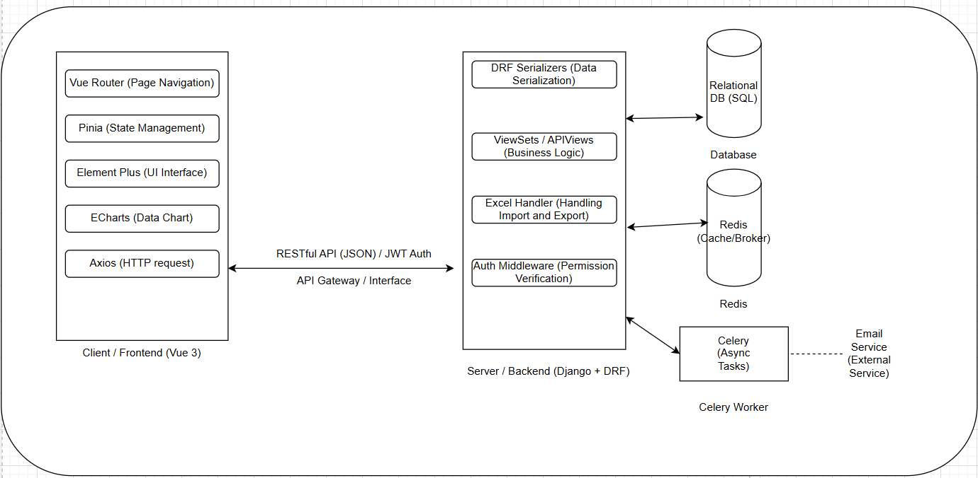
System Architecture
The framework taught in class is convenient for development, but it is not very conducive to collaborative development. To facilitate collaborative development, we adopted this front-end and back-end separated system architecture to meet our needs.

Slide 5
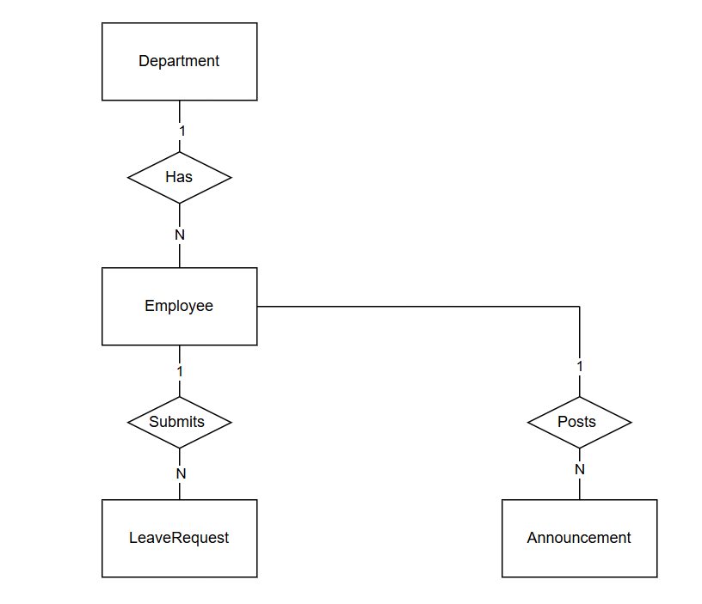
ER Diagram
Entity | Attributes (Bold = Primary Key, Italic = Foreign Key) | Description
Department | dept_id, dept_name, location | Stores organizational structure details.
Employee | user_id, username, password, role, dept_id | Stores user login credentials and links to a specific Department.
LeaveRequest | request_id, start_date, end_date, status, user_id | Stores leave application details linked to the Employee who submitted it.
Announcement | notice_id, title, content, create_time, user_id | Stores system notifications linked to the Administrator (Employee) who posted them.

Slide 6
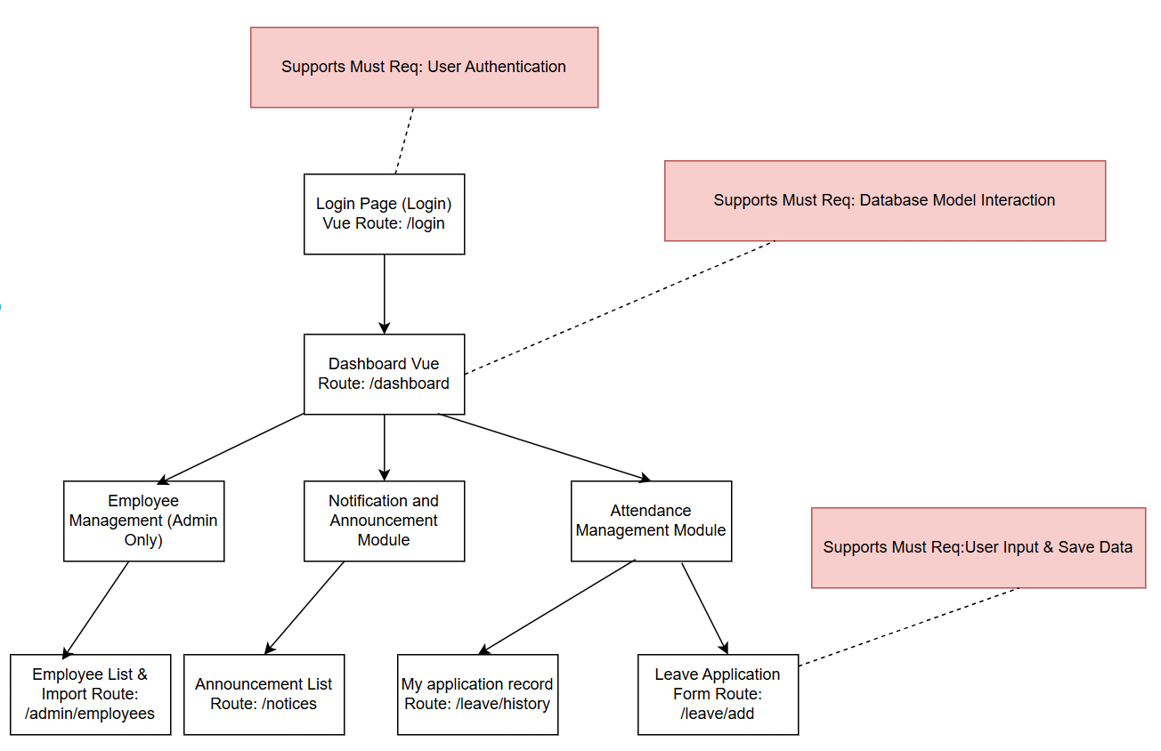
Site Map

Slide 7
Wireframes（Login Page）

Slide 8
Wireframes（Dashboard）

Slide 9
Wireframes（Leave Application Form）

Slide 10
Wireframes（Approval List / Management View）

Slide 11
Accessibility Plan (WCAG 2.2)
1.4.3 Contrast (Minimum)
Application: We will ensure a contrast ratio of at least 4.5:1 for all text on the Dashboard and Leave Application forms to make content readable for users with visual impairments.
2.1.1 Keyboard
Application: All functionality, including navigating the sidebar menu and submitting the leave request form, will be operable through a keyboard interface for users who cannot use a mouse.
2.4.7 Focus Visible
Application: The system will provide a highly visible focus indicator (e.g., a thick border) on the currently selected input field or button, helping keyboard users know where they are on the page.
3.3.2 Labels or Instructions
Application: Every input field in the login and application forms will have a clear, descriptive label (e.g., "Start Date", "Reason") to assist users in inputting data correctly.
3.3.1 Error Identification
Application: If a user submits an empty form or invalid date format, the system will identify the specific item that is in error and describe the error in text (e.g., "End date cannot be before Start date").

Slide 12
Appendix: Contributions & AI Statement
Team Member Contributions
Student Name | Contribution % | Main Responsibilities
Haoran Gu（3159487G） | 34% | Project management, System Architecture, Wireframes (Dashboard & Login), Final review.
Hanyu Zhang（3158754Z） | 33% | Specification (User Stories), ER Diagram design, Wireframes (Forms), Accessibility Plan.
Chuhan Su（3023779S） | 33% | Site Map structure, Database schema details, Overview slides, Presentation formatting.

